Slide 1
Google Data Analytics Cyclistic Capstone Project
July 11, 2022
Chien-Wei Chen

Slide 2
Agenda
Project overview, Data source and Goal
Data Analysis
Recommendations
Actionable steps
Q & A
Appendix

Slide 3
Overview
Data Source
Cyclistic has successfully developed its market in Chicago.
2 types of rider : Casual rider (Non-member) & Member rider
Member-riders are more profitable than casual rider
Upper echelon believes there is a very good chance to convert casual riders into members.
Provided by Cyclistic
Goal
Convert existing casual riders into members using marketing strategy and digital media.

Slide 4
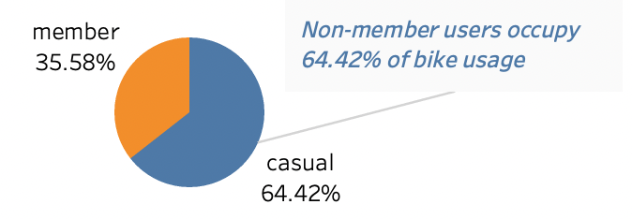
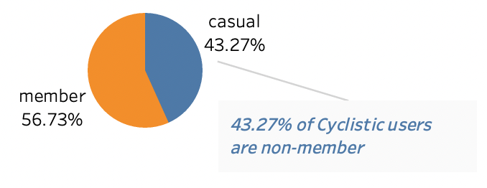
Data Analysis - 1
Rider Composition
Bike usage contribution
Calculation based on the sum of usage duration
Based on the total usage time, non-member users contribute nearly 65% of bike usage.
Notes:
The hypothesis made by upper echelon is correct

Slide 5
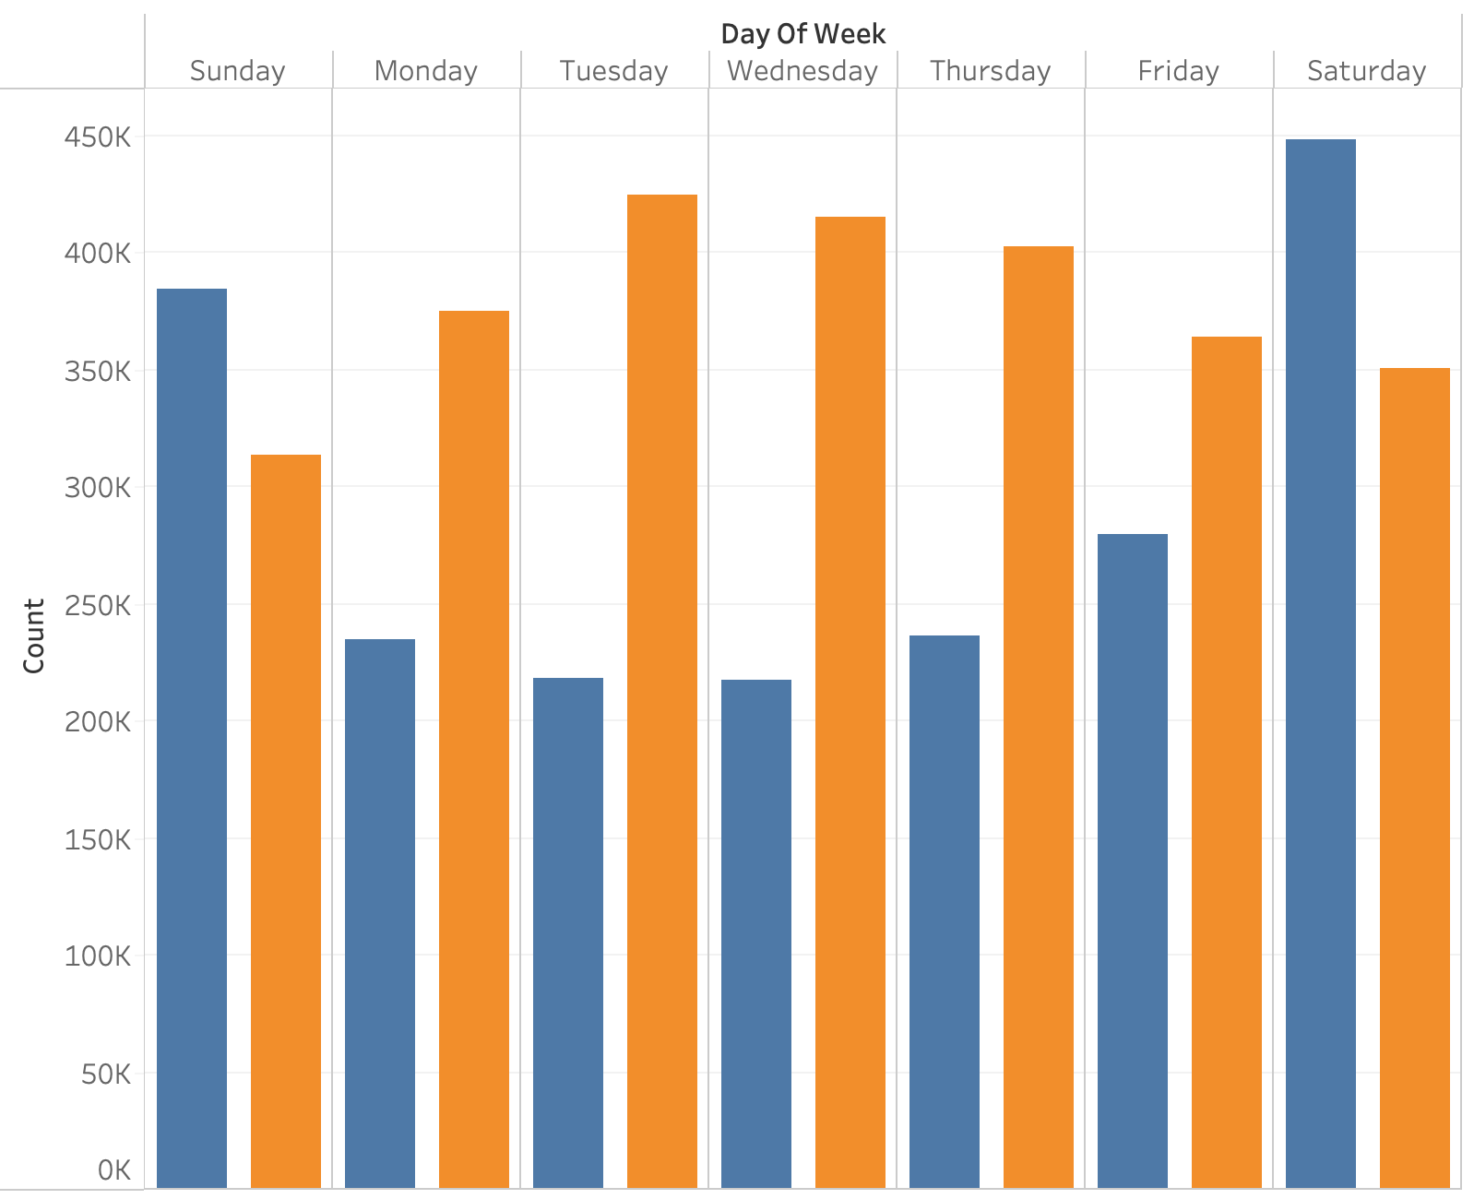
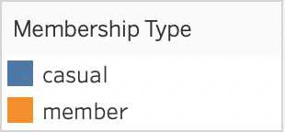
Data Analysis - 2
Bike usage pattern V.S Day of week
Member riders use bike primarily during weekdays. Roughly 130k difference between peak and nadir.
Casual riders use bike mostly during the weekend, with approximately 240k disparity between maximum and minimum

Slide 6
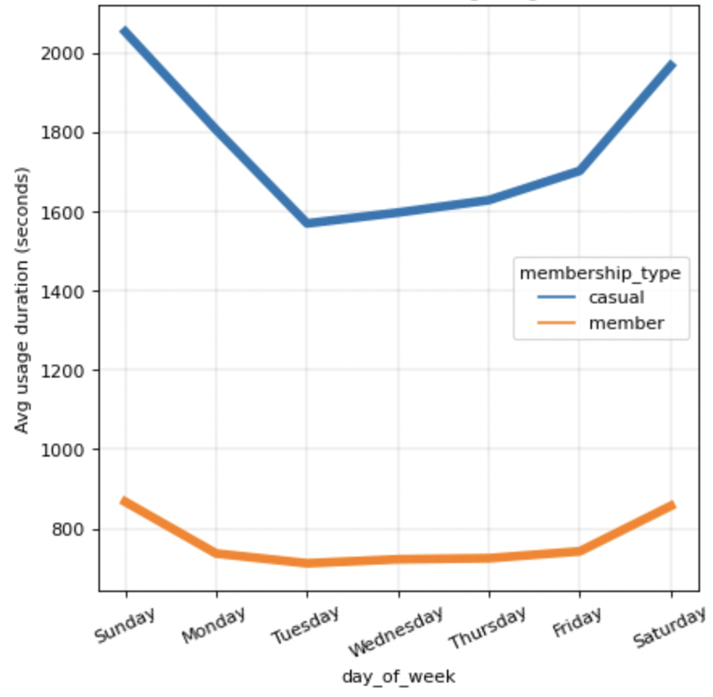
Data Analysis - 3
Member & Casual riders’ Avg. usage duration V.S Day of week
Casual users have higher average usage duration during weekend with large difference between weekend and weekday.
Member users have overall lower average usage duration with low fluctuation.
Notes:
Possible reason : Casual users ride bike for recreational or exercise purpose, while member users ride bike for commute purpose.

Slide 7
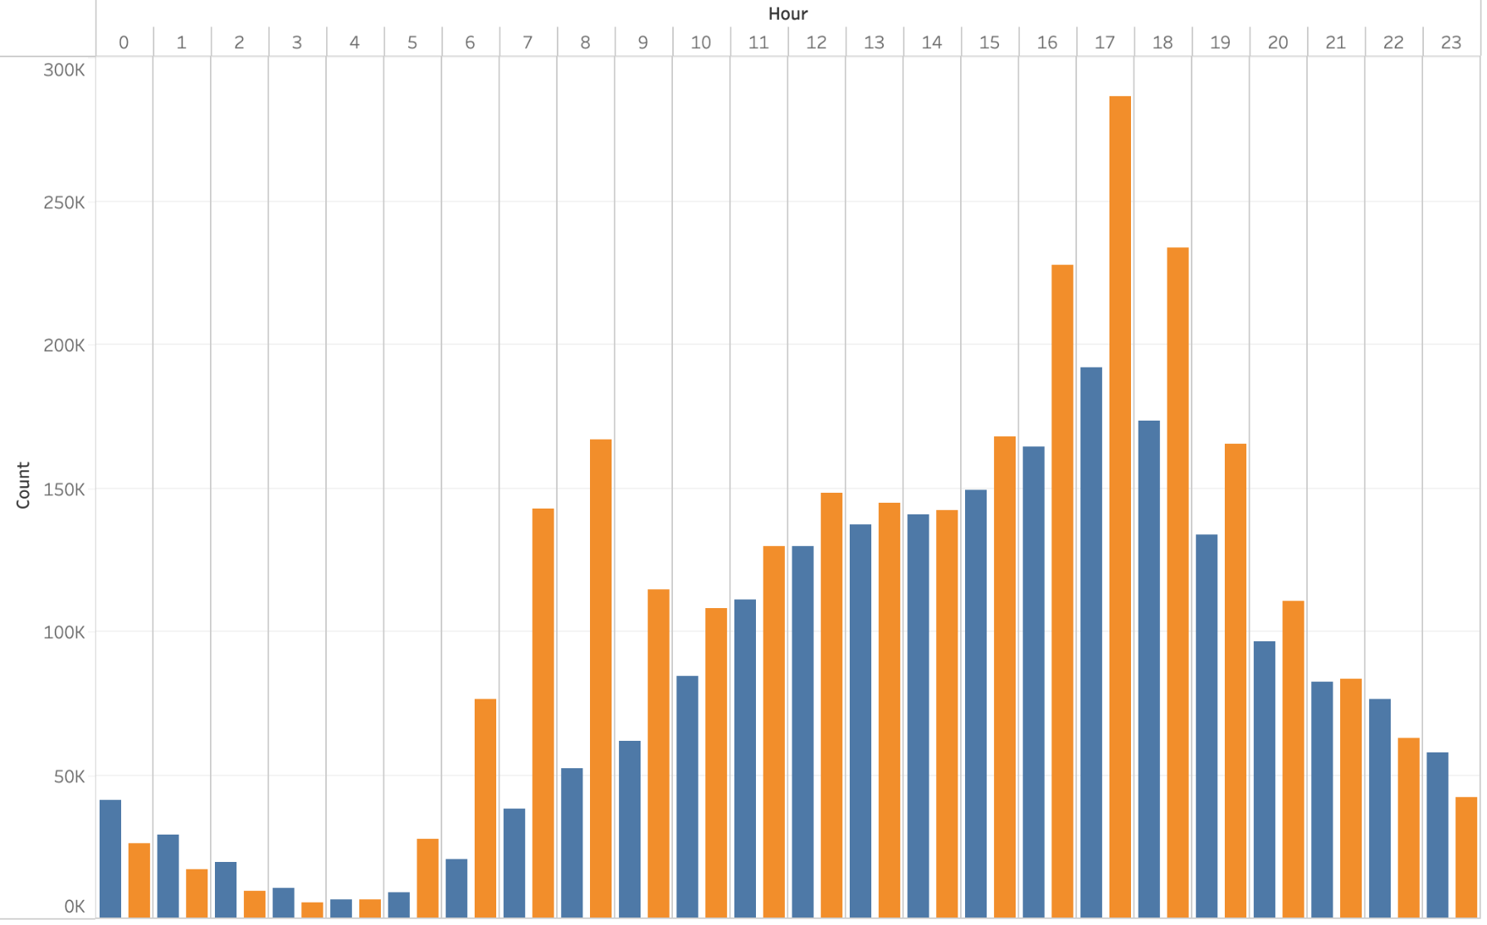
Data Analysis - 4
Bike usage pattern V.S Different hour within a day
2 peaks for member users, representing commute time
Notes:
Why the amount of commuting to work is less than that of commuting back home?
Possible reason: People might be afraid of being late, hence people might choose other transportation tools such as metro, bus or taxi. While going back home is less stressful.

Slide 8
Recommendations
Create another membership type that aims users who ride bike only on the weekend - Weekend Membership
Sending advertising info to casual users at right timing.
Understand what factors stopped weekend casual users from riding bike during weekday

Slide 9
Actionable steps
Come up with a membership pricing plan that’s tailored for weekend bike users.
Sending advertising emails to casual users on Friday evening and Saturday morning and evening.
Conduct a survey to understand the root cause of why most casual users not using Cyclistic for commute purpose.

Slide 10
Q & A

Slide 11
Appendix
Data Cleaning : Python
Data Analysis : Python
Data Visualization : Python & Tableau
See Jupyter Notebook and Tableau Dashboard for more detail.

